Slide 1
P-11 measure sites Ebara Left Side

Slide 2
Table of Contents
ZPRCMOSxxxxx jump to page
STPORAxxxxxx (Arachne MRAM Mask) jump to page
SDCGREYxxxxx jump to page
SL-12Hxxxxx TSV Process jump to page
M2 Monitor jump to page
OPTAGCU-xxxx V2 Level jump to page
MAPLESUBxxx/MAPLECHIPxxx M1 Level jump to page
MAPLESUB2 M1 level (Ginko Mask) jump to page
MINNIExxxx/EVELYNxxxx (BR549 – BE Mask) Nb Polish jump to page
SMITHxxxx TSV Polish jump to page
V10xxxx TSV Polish jump to page
RR1T1R-xxxxx jump to page
RIVERxx (Hudson Mask) – TSV jump to page
NIAGARAxxxx V1– TSV jump to page
NIAGARAxxxx V1RevB jump to page

Slide 3
Table of Contents
OPTAGCU-xxxx M2 Level jump to page
PCM (Disruptor Mask) MT level jump to page
NVTSIxxxx – Bar TSV jump to page
X2-SPHINXxxx - Cu TSV jump to page
RRAMDEVE**** (Neuro) – Mx Copper jump to page
QBERTV - M1 + ZG jump to page
HARRYxxxx – ALP Mask jump to page
DELAWARE – Nb CMP jump to page
Grinch Mask – TSV Polish jump to page
CWCOH2 – MATCH_V2 Mask jump to page
JETSxxx - Poly TSV – TZ mask jump to page
BIOELECxxxx – Copper Polish jump to page
FREYLBFxxxx – Nb CMP – Lhotse Mask jump to page
HBRCHxxxx - HEXBERT - LO/Match Mask - jump to page
JETSxxx – Backside TSV – TZ jump to page
SMCSIPVxxxx – Small Processor Copper jump to page
LANMARxxxx – Nb CMP – Mariana Mask jump to page
SMCSIPFRxxx - Small Processor M1 Copper jump to page
SMCSIPTCxxx – Small Processor Copper jump to page
K-BA01xxx – Copper CMP – KATLA Mask jump to page
AH-DCOWxxxx – Nb CMP - CW-V1-ZL-DE Mask jump to page

Slide 4
ZPRCMOSxxxxx ILD Polish
FTA8
Center
X= +7137
Y= +6133
Mid
X= +7579
Y= +41910
Edge
X= +8030
Y= +77677
Blackbird Kerf
Center
X= -3472
Y= +8001
Mid
X= -3008
Y= +43771
Edge
X= -2599
Y= +79548
** Notch Left

Slide 5
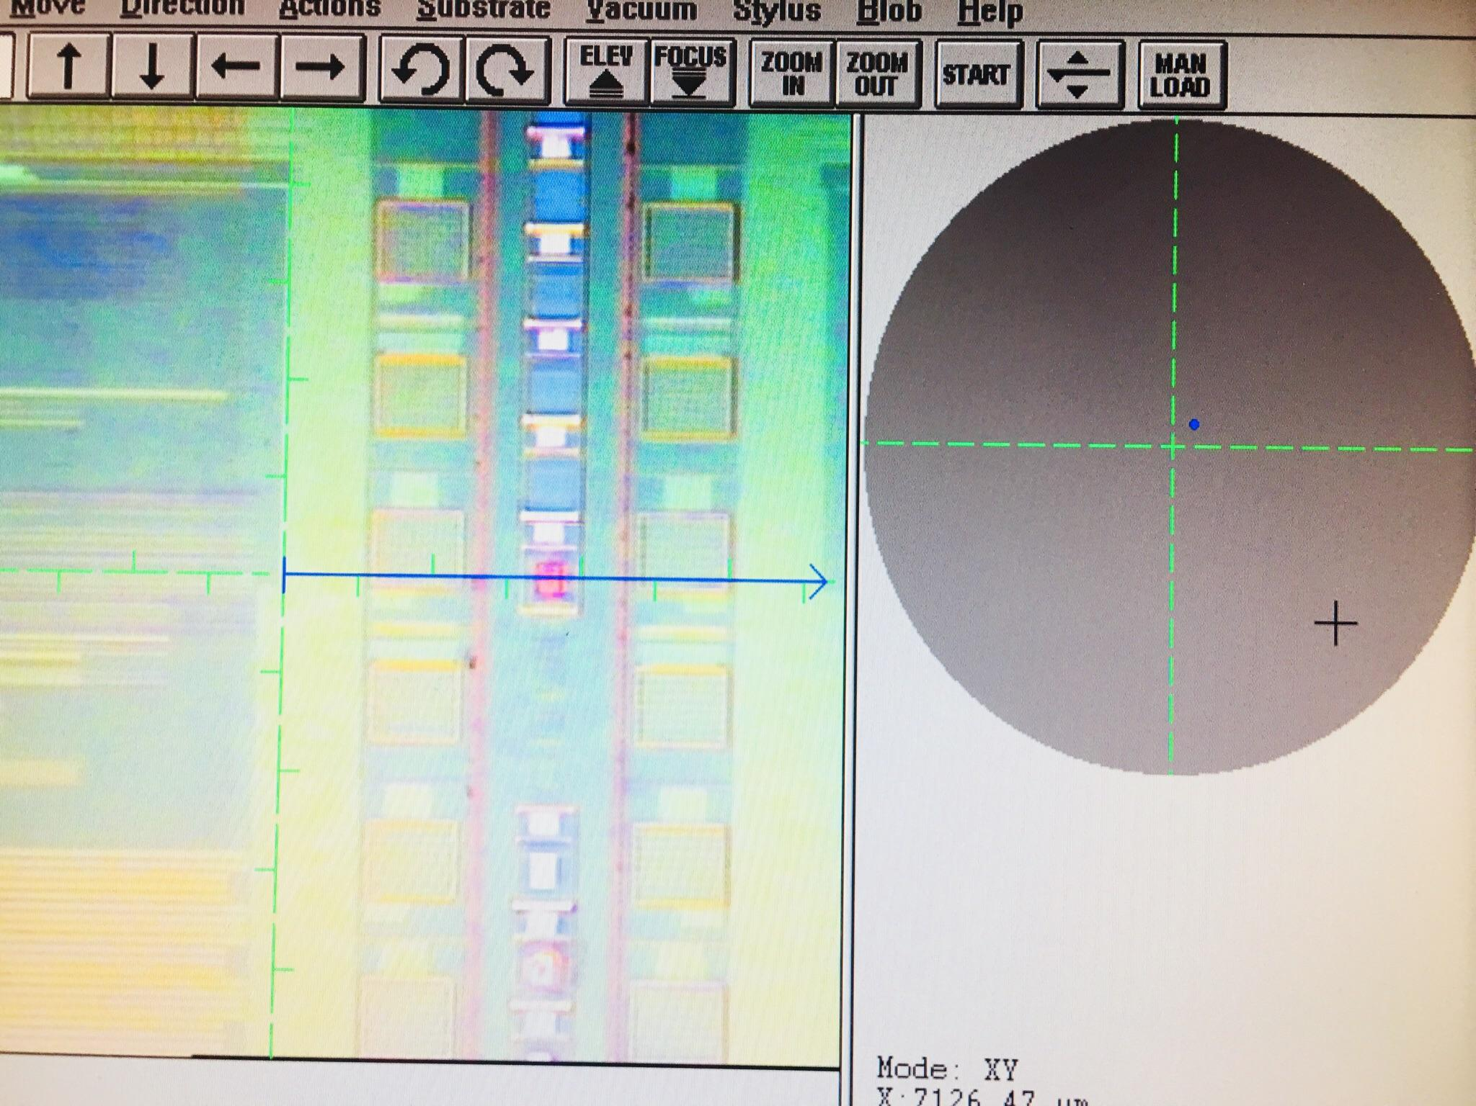
FTA 8

Slide 6
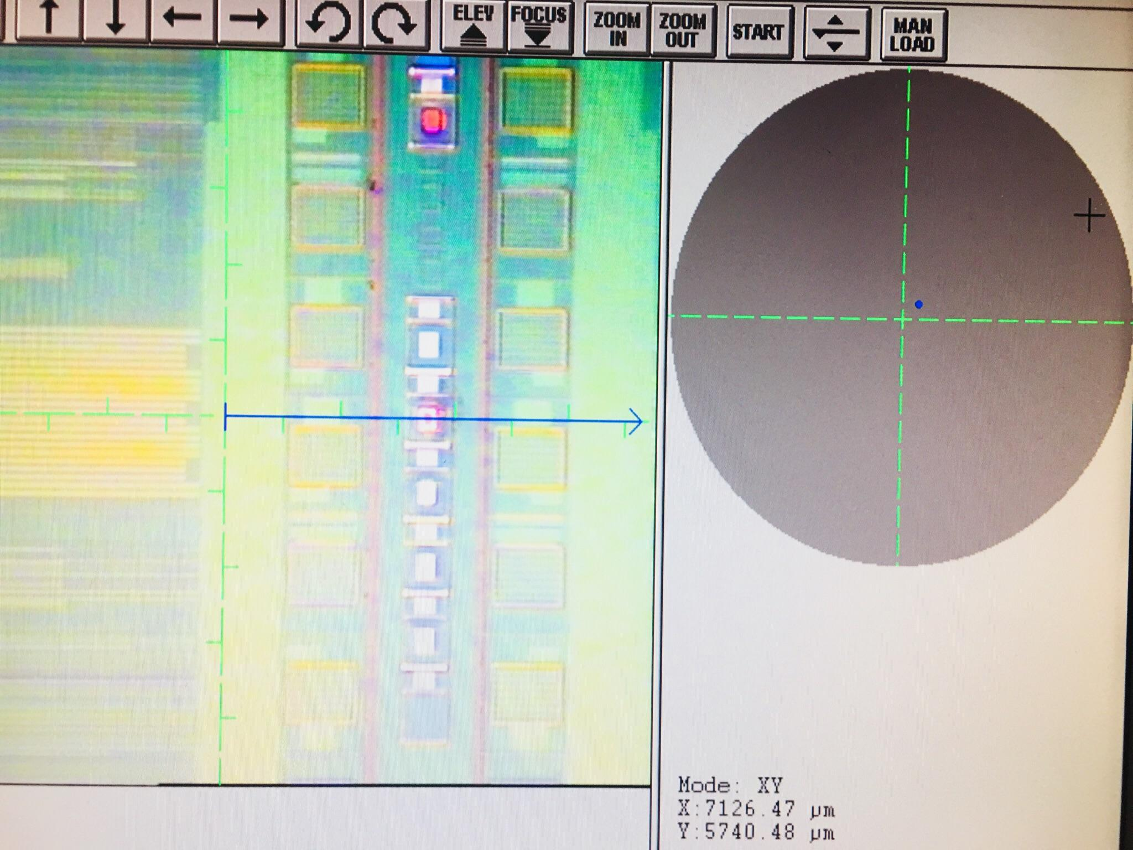
FTA 4

Slide 7
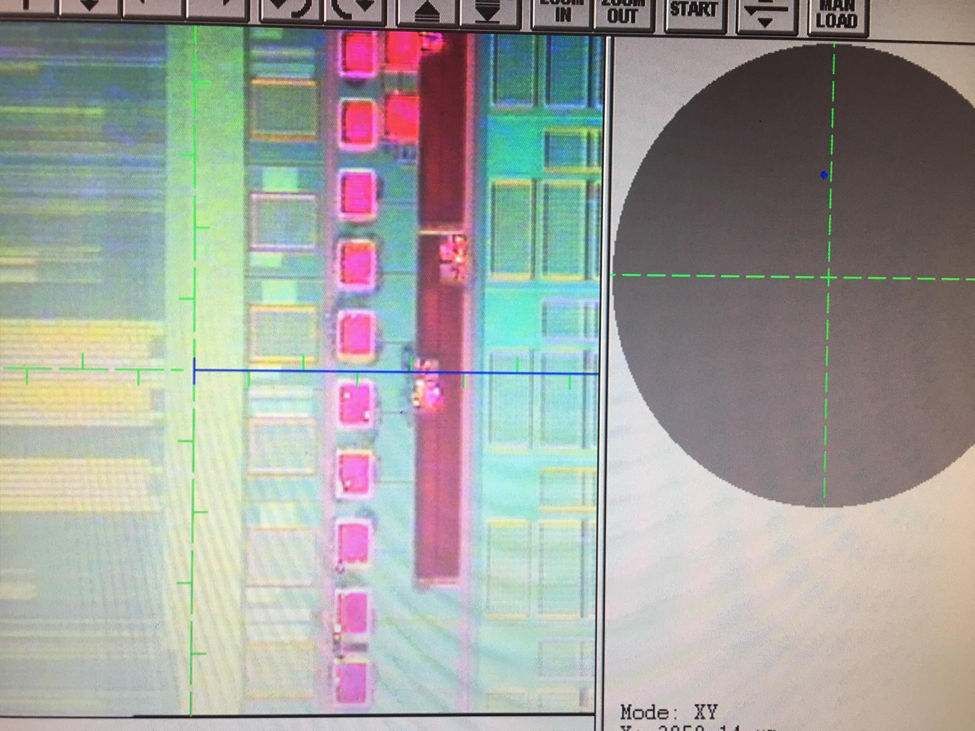
Blackbird
Kerf

Slide 8
STPORAxxxxxx (Arachne MRAM Mask)
FTA 5 (Up Area)
FTA 6 (Down Area)
Center
X= -1232
Y= -5278
Mid
X= -623
Y= +34961
Edge
X= -158
Y= +75119
** Notch left

Slide 9
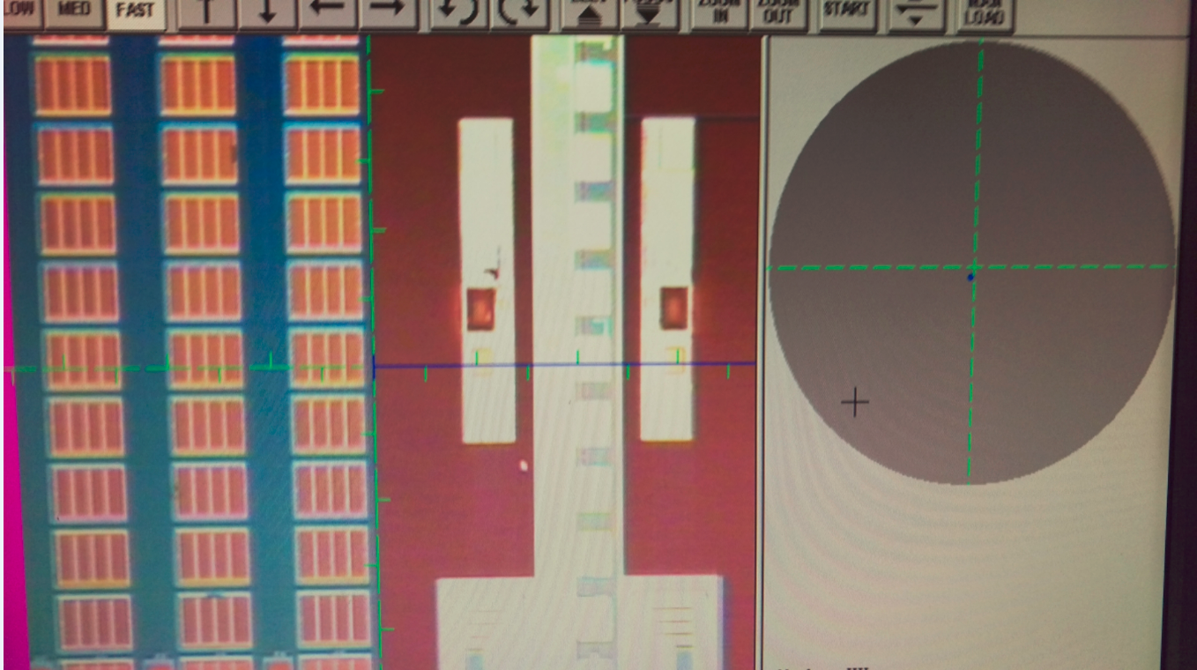
STPORAxxxxxx (Arachne MRAM Mask)
FTA 5
FTA 6

Slide 10
SDCGREYxxxxx (EVDAMV3)
Home Plate
Center
X= -5735
Y= -3190
Mid
X= -51695
Y= -2700
Edge
X= -74696
Y= -2433
Kerf
Center
X= -12591
Y= -3052
Mid
X= -58595
Y= -2670
Edge
X= -81596
Y= -2433
** Notch left

Slide 11
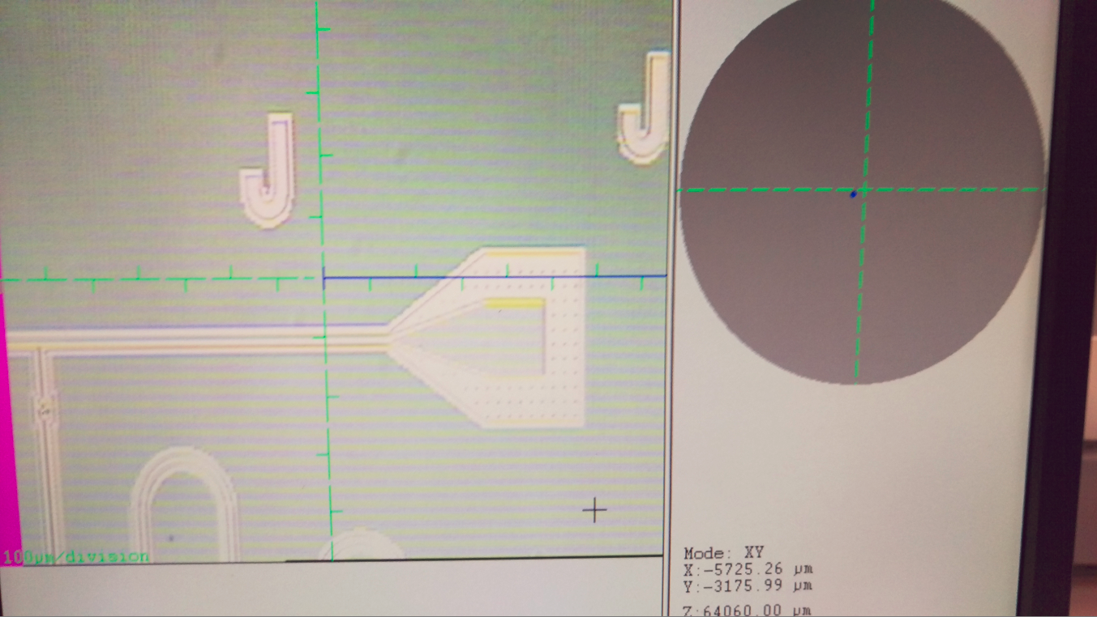
SDCGREYxxxx EVDAMV3 mask
Home Plate

Slide 12
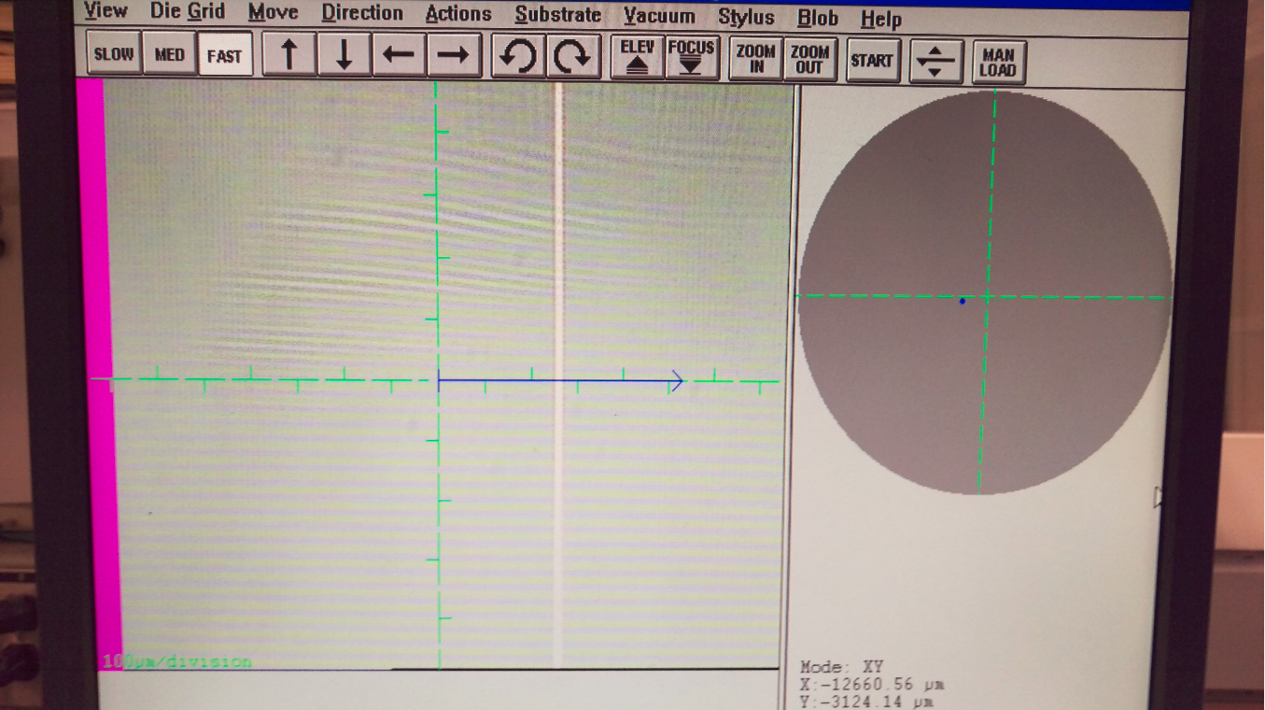
SDCGREYxxxx EVDAMV3 mask
Kerf

Slide 13
SL-12Hxxxxx – TSV Process
TSV
Center
X= +1011
Y= -5373
Mid
X= -41381
Y= -5042
Edge
X= -72170
Y= -4450
** Notch left

Slide 14
M2 Monitor
FTA 3
Center
X= -1279
Y= -1895
Mid
X= -802
Y= +37004
Edge
X= -314
Y= +75905
** Notch left

Slide 15
OPTAGCU-xxxx V2 Level
Center
X= +26100
Y= -5421
Mid
X= +26408
Y= +40059
Edge
X= +26887
Y= +78540
** Notch up

Slide 16
MAPLESUBxxx M1 Level
Dogbone
Center
X= -1090
Y= +2040
Mid
X= -629
Y= +38032
Edge
X= -167
Y= +74003
** Notch up

Slide 17
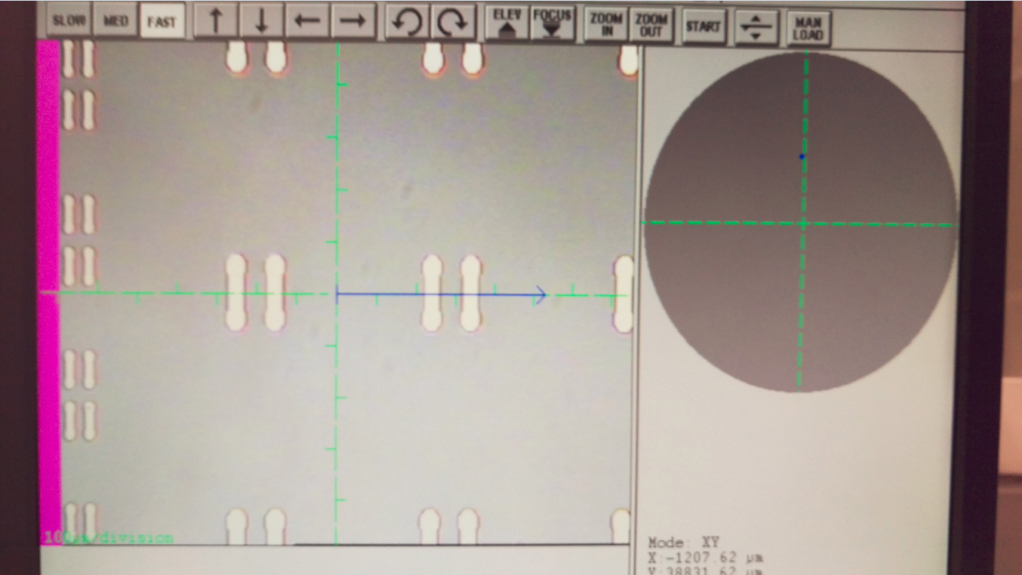
MAPLECHPxxxx
Dogbones

Slide 18
MAPLESUB2 M1 Level (Ginko Mask)
Copper Pad
Center
X= +3574
Y= +2918
Mid
X= +4018
Y= +38900
Edge
X= +4473
Y= +74895
** Notch Up

Slide 19
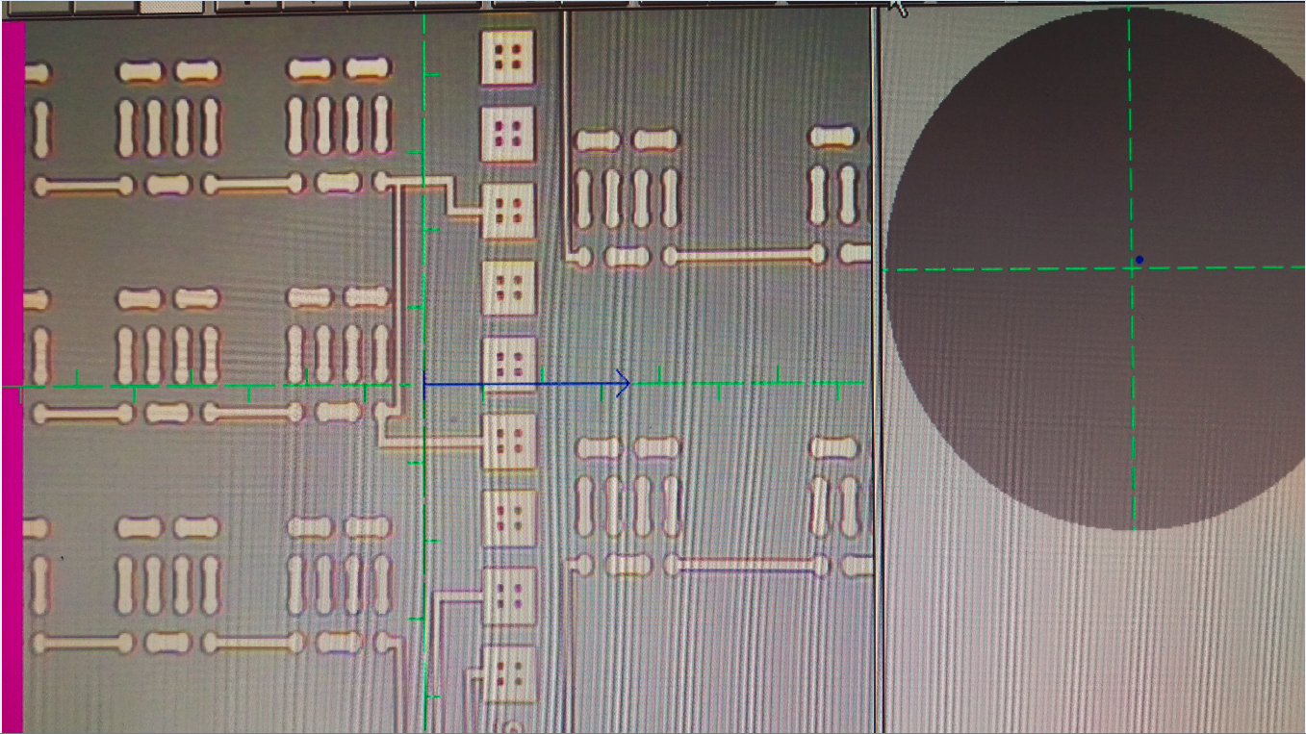
MAPLESUB2 M1 (Ginko Mask)

Slide 20
MINNIExxxx/EVELYNxxxx (BR549 – BE Mask) - Nb Polish
Double Home Plate
Center
X= +10000
Y= -9500
Mid
X= +10000
Y= +32000
Edge
X= +10000
Y= +73000
** Notch left

Slide 21
SMITHxxxx – TSV Polish
Center
X= -4140
Y= -4166
Mid
X= -43055
Y= -3514
Edge
X= -64326
Y= -3392
** Notch left

Slide 22
V10xxxx TSV Polish
Center
X= -3492
Y= -3203
Mid
X= -39623
Y= -2378
Edge
X= -67472
Y= -2639
** Notch left

Slide 23
RR1T1R-xxxxx – M1 Polish
FTA 2
Center
X= 8246
Y= 7643
Mid
X= -48378
Y= -7161
Edge
X= -68551
Y= -6884
** Notch up

Slide 24
RIVERxx (Hudson Mask) – TSV level
Center
X= +12197
Y= -5345
Mid
X= +13132
Y= +36642
Edge
X= +13739
Y= +68475
** Notch left

Slide 25
NIAGARAxxxx V1 - TSV Polish
Center
X= +8820
Y= - 6455
Mid
X= + 8400
Y= + 31940
Edge
X= +7767
Y= +70316
** Notch left

Slide 26
NIAGARAxxxx V1RevB - TSV Polish
Center
X= +7897
Y= - 1975
Mid
X= + 7859
Y= + 37604
Edge
X= +7812
Y= +74793
** Notch left

Slide 27
OPTAGCU-xxxx M2 Level
M2 Cu Pad (group of three)
Center
X= -9895
Y= -8485
Mid
X= -9357
Y= +33500
Edge
X= -8833
Y= +75472
** Notch left

Slide 28
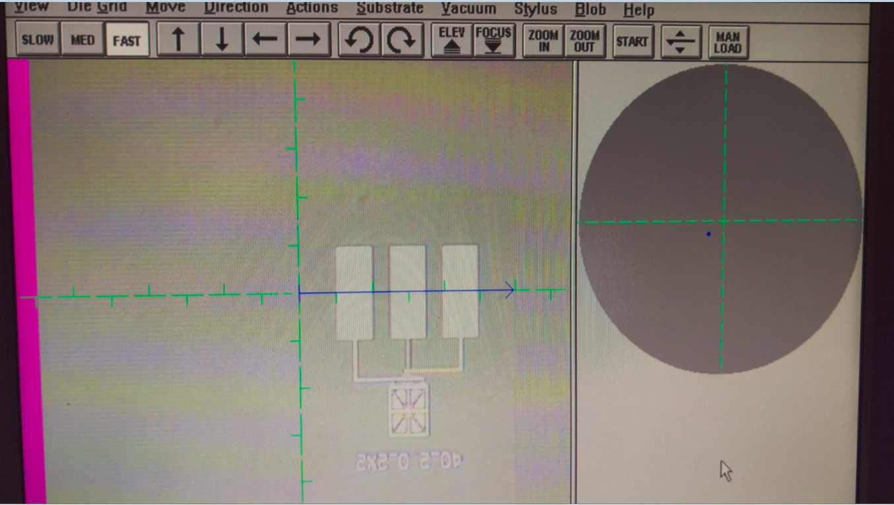
OPTAGCU
M2 Cu Pads

Slide 29
PCM Disruptor Mask
Field →Rectangle
Field → RX Pad
Center
X = +2208
Y = +5924
Mid
X = 2208
Y = +46103
Edge
X = +2929
Y = +86227
** Notch left

Slide 30
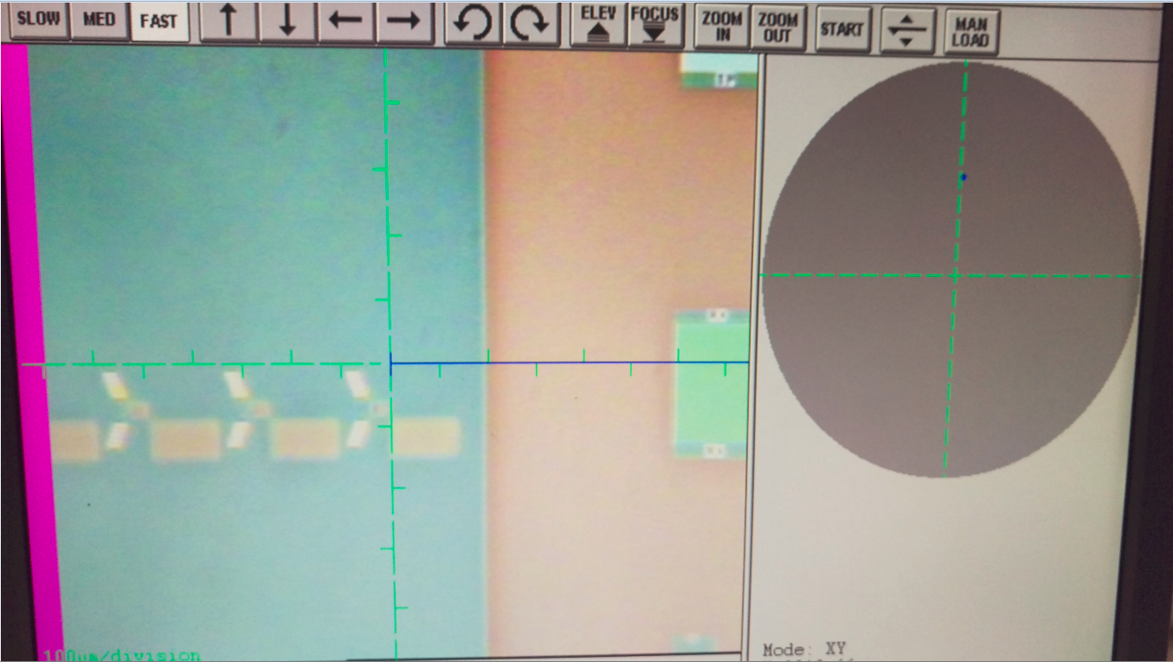
PCM Disruptor mask

Slide 31
NVTSIOxxxx – Bar TSV
Center
X = +9302
Y = +10512
Mid
X = + 9748
Y = + 51098
Edge
X = + 9968
Y = + 70689
** Notch up --- Use 10um/sec @ 500Hz

Slide 32
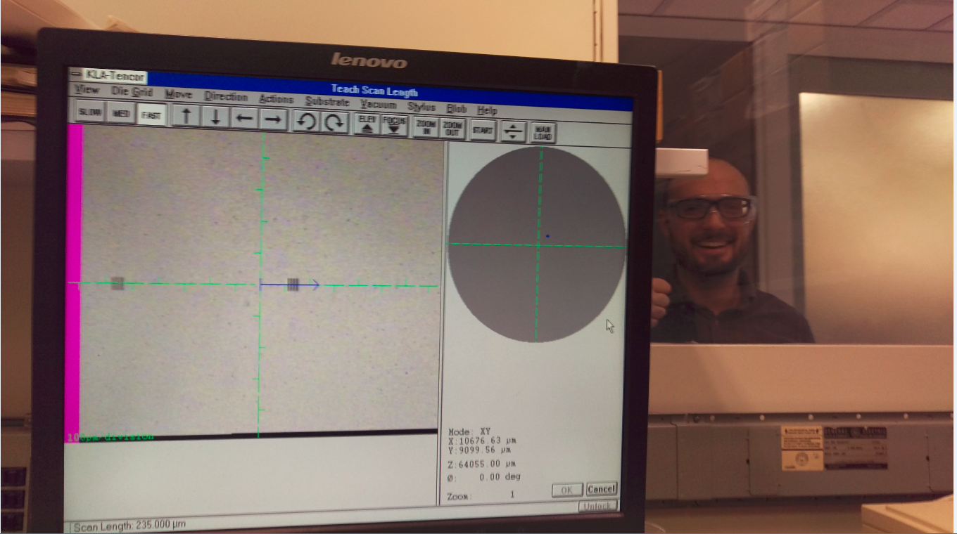

Slide 33
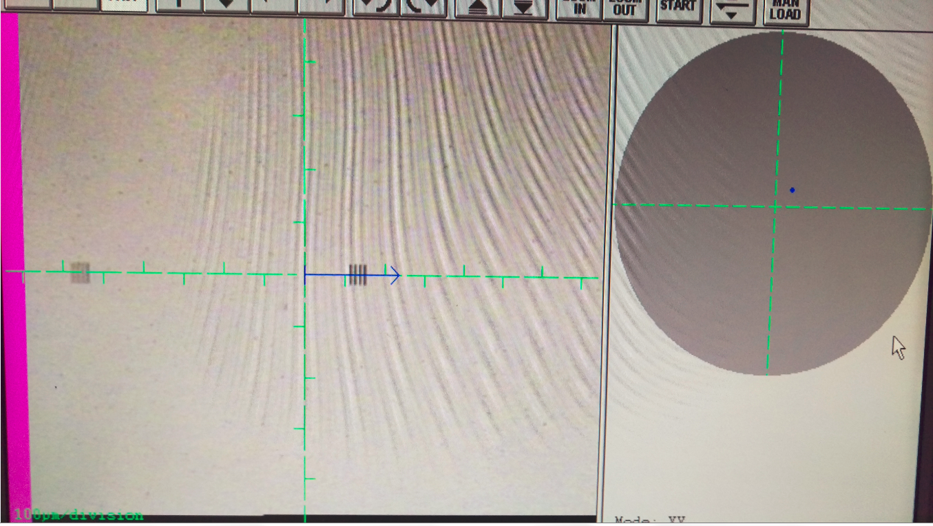
NVTSIOxxx

Slide 34
X2-SPHINXxxx (Hudson Mask) – TSV level
Center
X= +4812
Y= -1338
Mid
X= +4812
Y= +39821
Edge
X= +4812
Y= +70605
** Notch left

Slide 35
RRAMDEVE*** (Neuro) – Mx Copper/Liner
FTA 2
Center
X= -8339
Y= +4477
Mid
X= -8030
Y= +32827
Edge
X= -7583
Y= +73158
** Notch Up

Slide 36
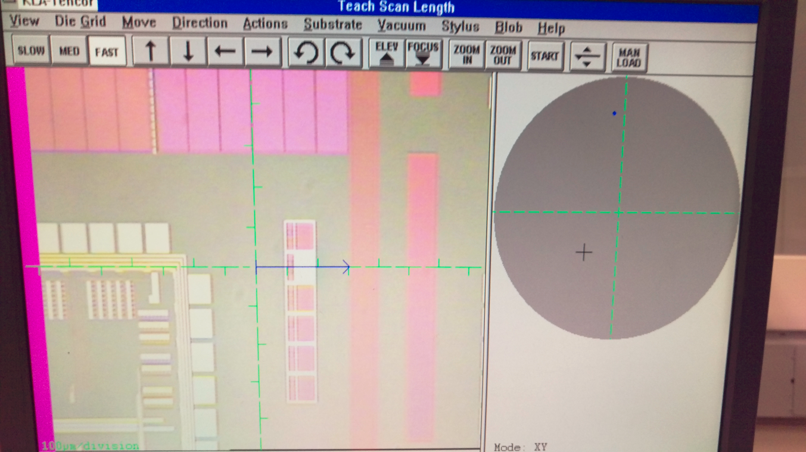
RRAMDEVE***

Slide 37
QBERTV1 – M1 + ZG
Measure in Nb Damascene Feature
Center
X= +1442
Y= +5212
Edge
X= +2138
Y= +68786
** Notch Up

Slide 38
HARRYxxxx - ALP Mask
Box 2 Pre Polish
Center
X= -617
Y= -10500
Mid
X= +52502
Y= -11092
Edge
X= +78876
Y= -11354
** Notch Left
Rotate wafer 90 degrees for post measurements – report Box 1 and Box 2 for post
Box 1 and 2 Post Polish
Center
X= -10500
Y= -617
Mid
X= -10092
Y= +52502
Edge
X= -9743
Y= +79546

Slide 39
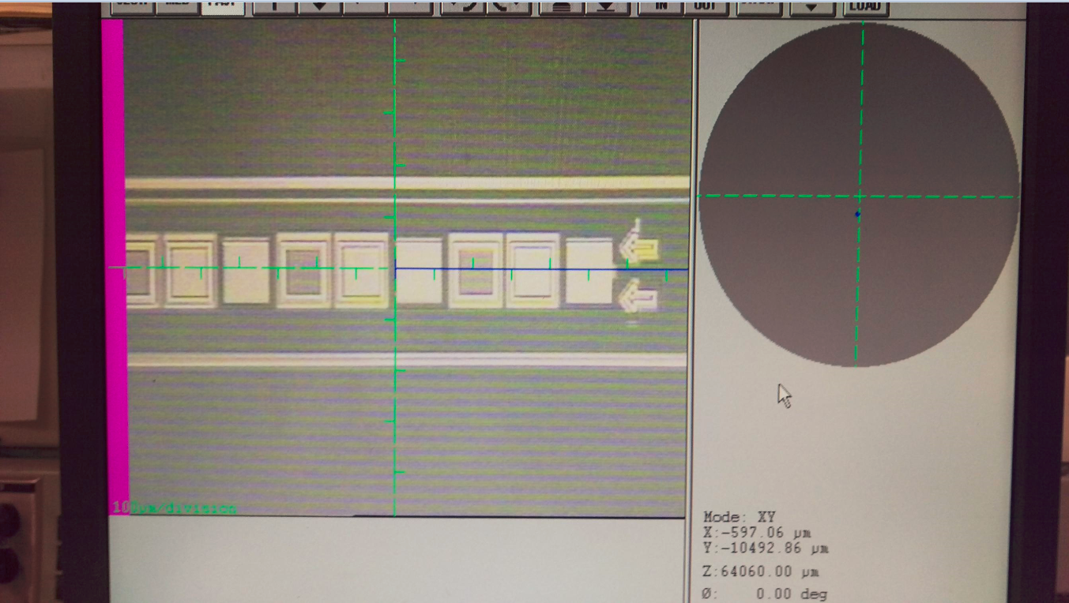
Box 2

Slide 40
DELAWARE Mask – Nb CMP
Narrow Line and TSV
Center
X= +6423
Y= -7194
Mid
X= -31963
Y= -6140
Edge
X= -79554
Y= -5833
** Notch Up

Slide 41
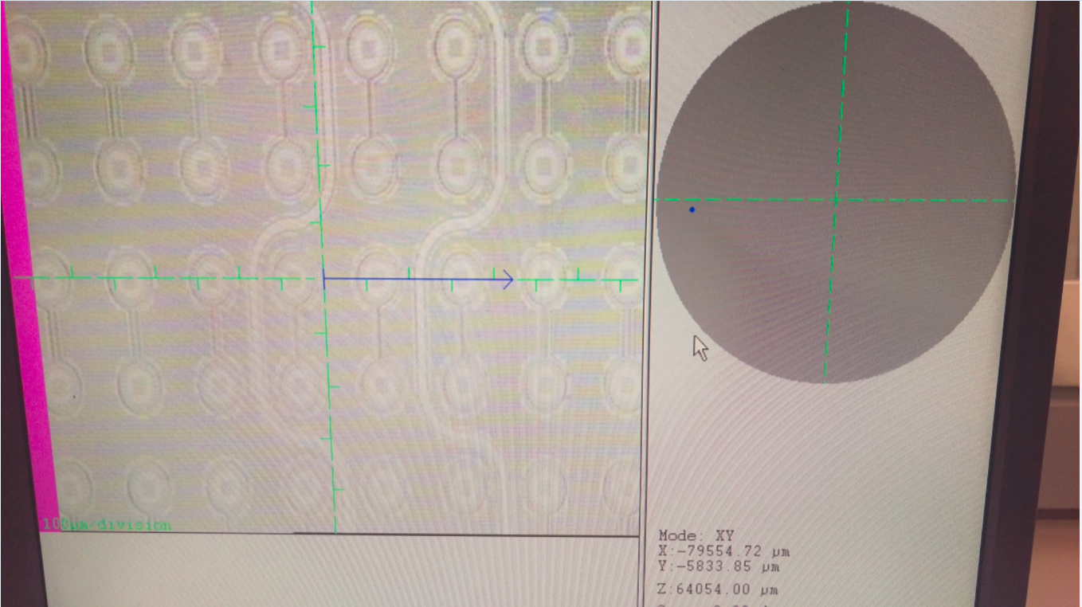
TSV
TSV
Narrow Line

Slide 42
Grinch Mask – TSV CMP
TSV
Center
X= +3526
Y= -3942
Mid
X= +3668
Y= +38448
Edge
X= +3519
Y= +77282
** Notch Left

Slide 43
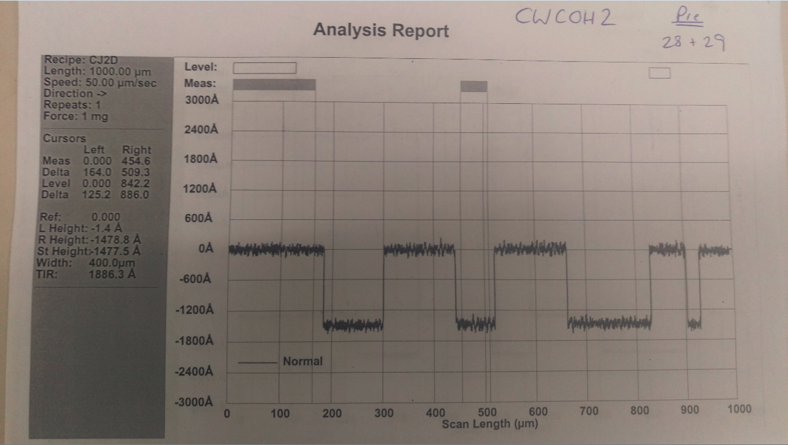
MATCH_v2 Mask
Center
X= -1091
Y= -83
Mid
X= -513
Y= +54554
Edge
X= -230
Y= +81868
** Notch Up

Slide 44
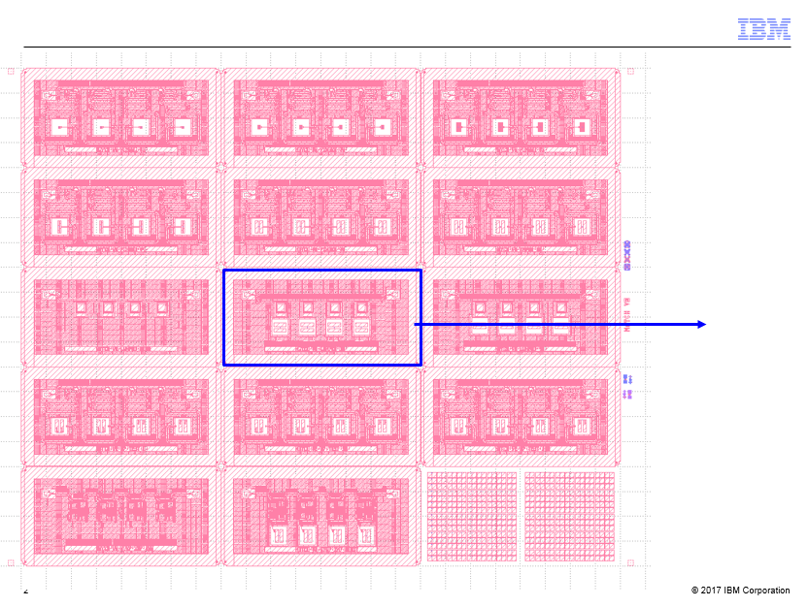
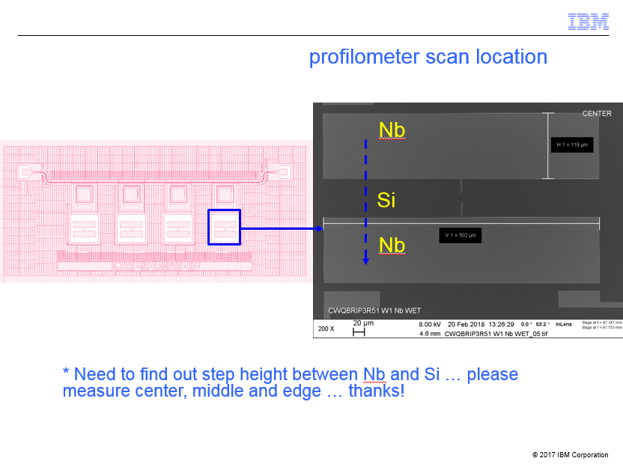
MATCH v2 Mask

Slide 45
JETSxxx - TZ Mask – TSV CMP
TSV
Center
X= -2541
Y= -11777
Mid
X= -32446
Y= -9794
Edge
X= -69857
Y= -5827
** Notch Up

Slide 46
BIOELECxxxx – Copper/Liner Polish
Wide Line
Center
X= +5082
Y= -2442
Mid
X= +4518
Y= +37643
Edge
X= +3958
Y= +77522
** Notch Up

Slide 47
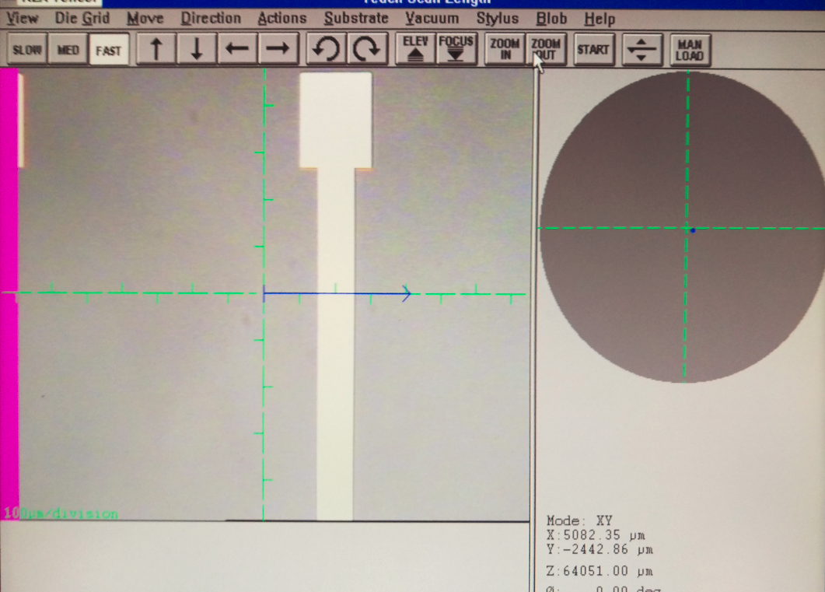
BIOELECxxxx

Slide 48
FREYLFBxxxx – Nb CMP – Lhotse Mask
Nb exclude region
Center
X= +4385
Y= -6936
Mid
X= +4877
Y= +40462
Edge
X= +5188
Y= +72029
** Notch Left

Slide 49
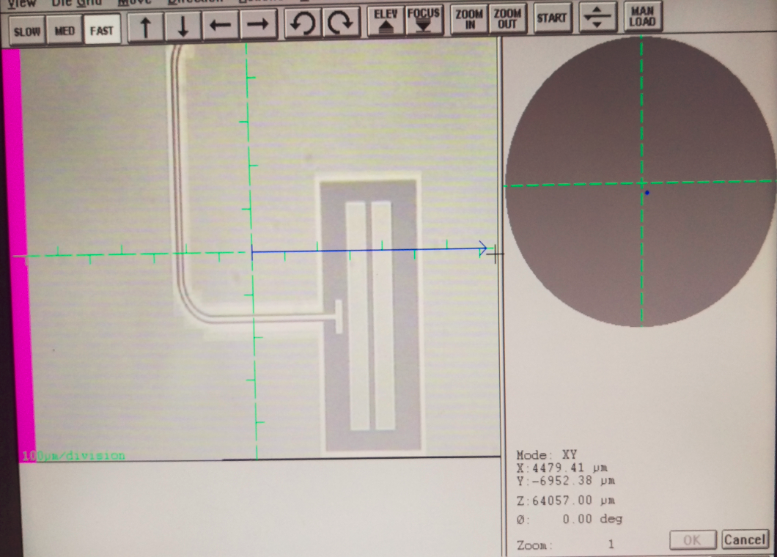
FREYLFBxxx – Lhotse Mask
Nb exclude region

Slide 50
HBRCHxxxx – HEXBERT – LO / MATCH Mask
Measuring from the DOWN (silicon) area to the UP (Nb) area
Center
X= +1464
Y= +6250
Mid
X= +178
Y= +36290
Edge
X= +739
Y= +77539
** Notch Up

Slide 51
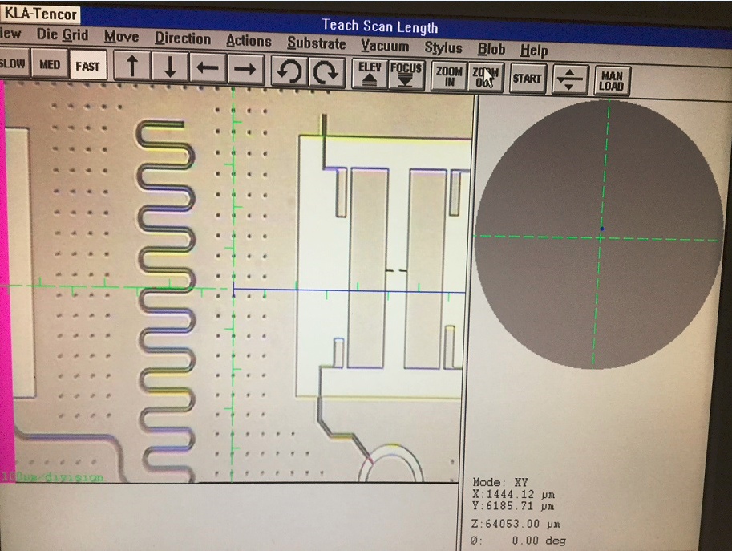
HBRCHxxxx – LO/Match Mask

Slide 52
JETS – TZ mask (Backside TSV)
Horseshoe shaped TSV
Center
X= +1508
Y= +138
Mid
X= +2017
Y= +41515
Edge
X= -2092
Y= +76961
** Notch Left
Horseshoe opens LEFT (scan hits center dot FIRST, then ring)

Slide 53
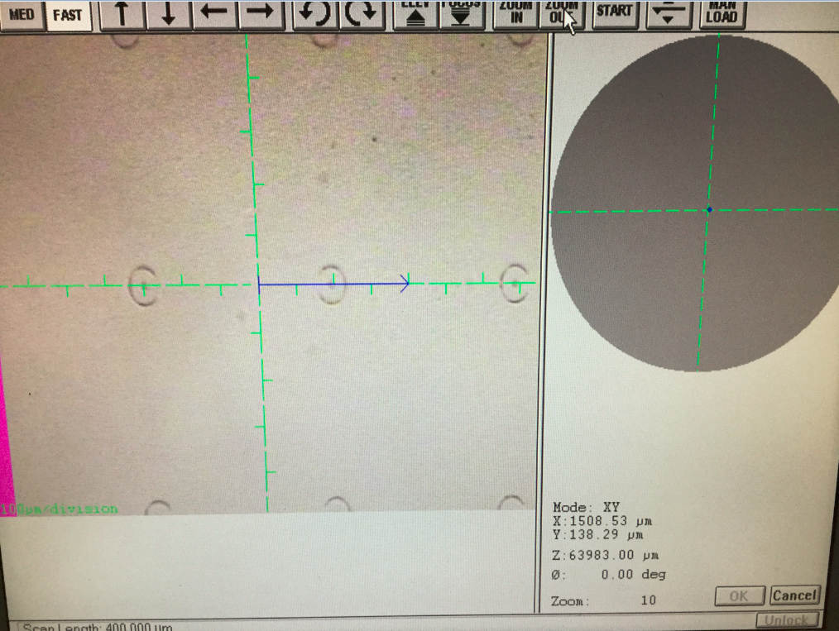
JETSxxx – Backside TSV
Horseshoe TSV

Slide 54
SMCSIPVxxxx – Small Processor - Copper
Copper Trenches
Center
X= +1823
Y= -2507
Mid
X= +2338
Y= +36766
Edge
X= +2800
Y= +75091
** Notch Left

Slide 55
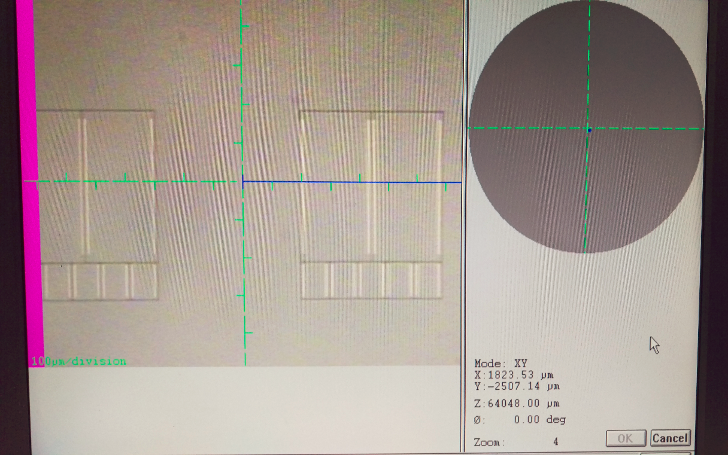
SMCSIPVxxxx – Small Processor - Copper
Copper Trenches

Slide 56
LANMARxxxx – Nb CMP – Mariana Mask
Copper Trenches
Center
X= +6402
Y= -4878
Mid
X= +6852
Y= +39135
Edge
X= +7208
Y= +73138
** Notch Left

Slide 57
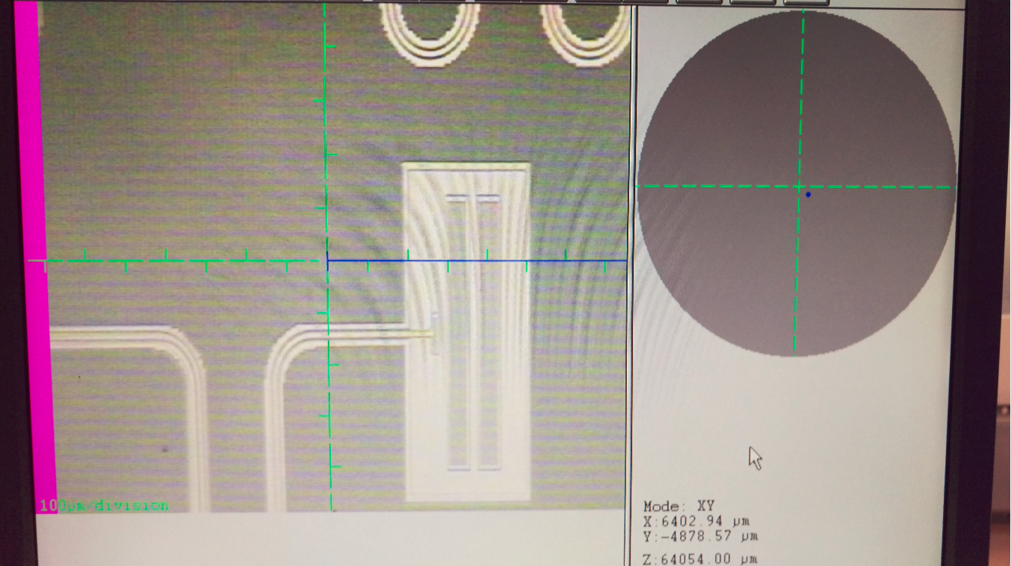
LANMARxxxx
Nb Exclude Region

Slide 58
SMCSIPFRxxxx – M1 Copper
Copper Trenches
Center
X= +705
Y= -2759
Mid
X= +1282
Y= +39233
Edge
X= +1847
Y= +81547
** Notch Left

Slide 59
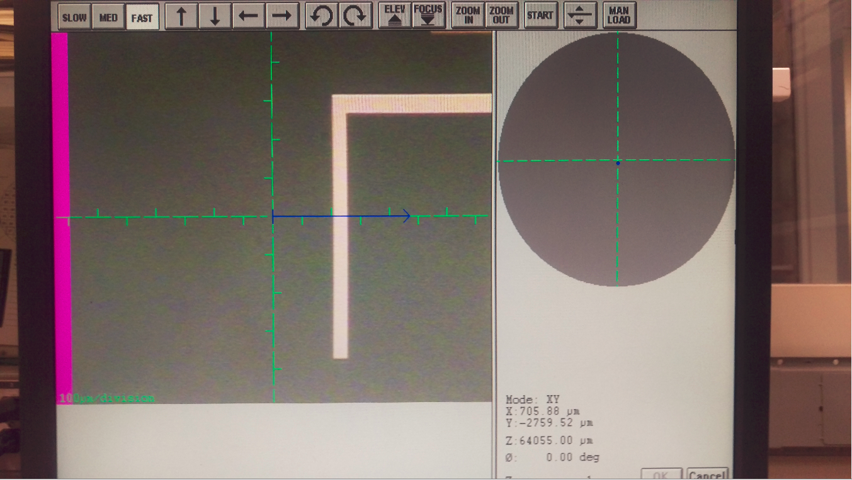
SMCSIPFRxxx – M1

Slide 60
SMCSIPTCxxxx – Copper CMP
Copper Pad
Center
X= -8455
Y= +9642
Mid
X= -8138
Y= +39226
Edge
X= -7779
Y= +73380
** Notch Left

Slide 61
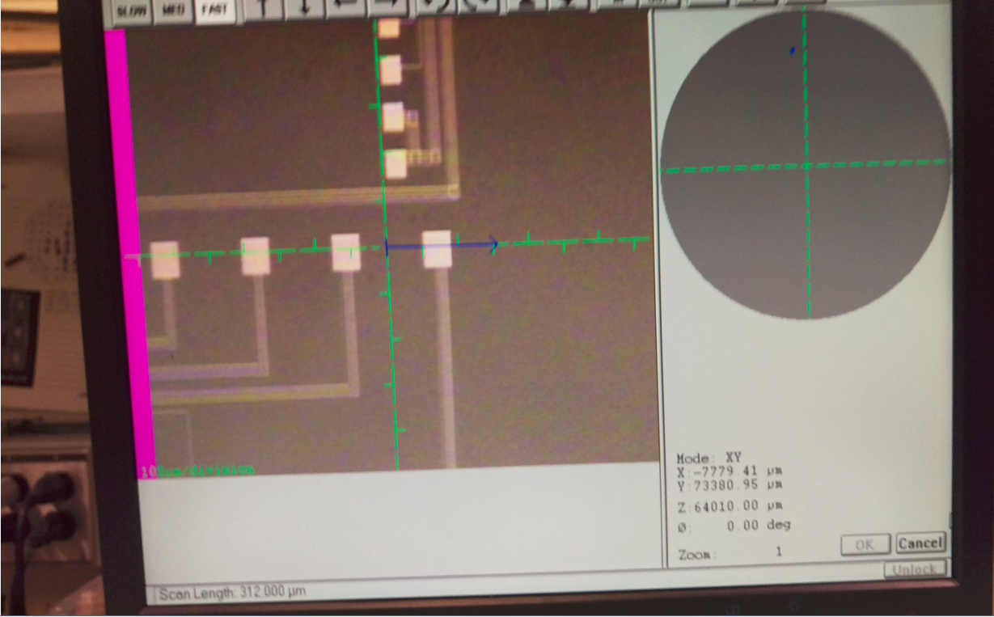
SMCSIPTCxxxx Copper CMP
Copper pad

Slide 62
K-BA01xxxx – Copper CMP
House/Basement
Center
X= -10959
Y= -7502
Mid
X= -10600
Y= +32195
Edge
X= -10385
Y= +71766
** Notch up
* Report Field→House and House→Basement – The Triangle area to the left of the basement can be used as the House (it measures the same as the house on the P11 and UV1280)

Slide 63
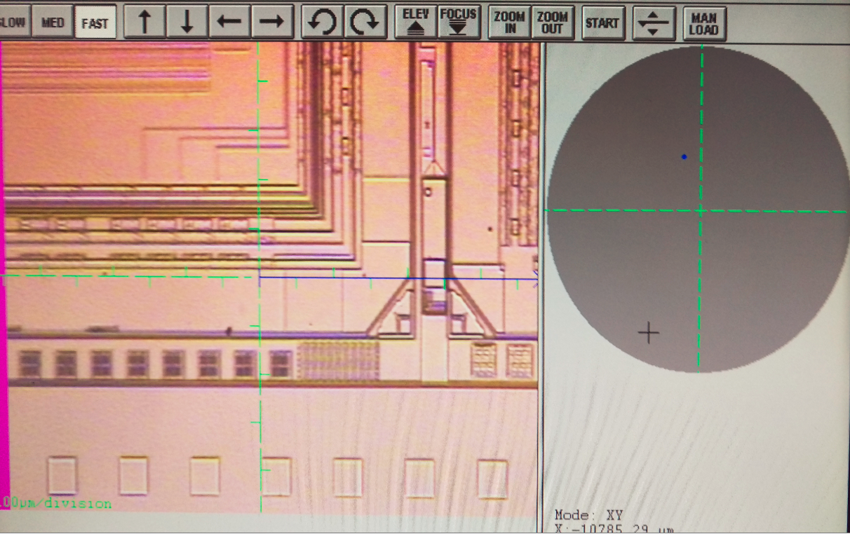
K-BA01XXX – KATLA Mask
Basement
House
Field

Slide 64
AH-DCOWxxxx - CW-V1-ZL-DE Mask – Nb CMP
Homeplate/Kerf
Center
X= +10364
Y= - 5654
Mid
X= - 44411
Y= - 5062
Edge
X= - 71799
Y= - 4759
** Notch Left

Slide 65
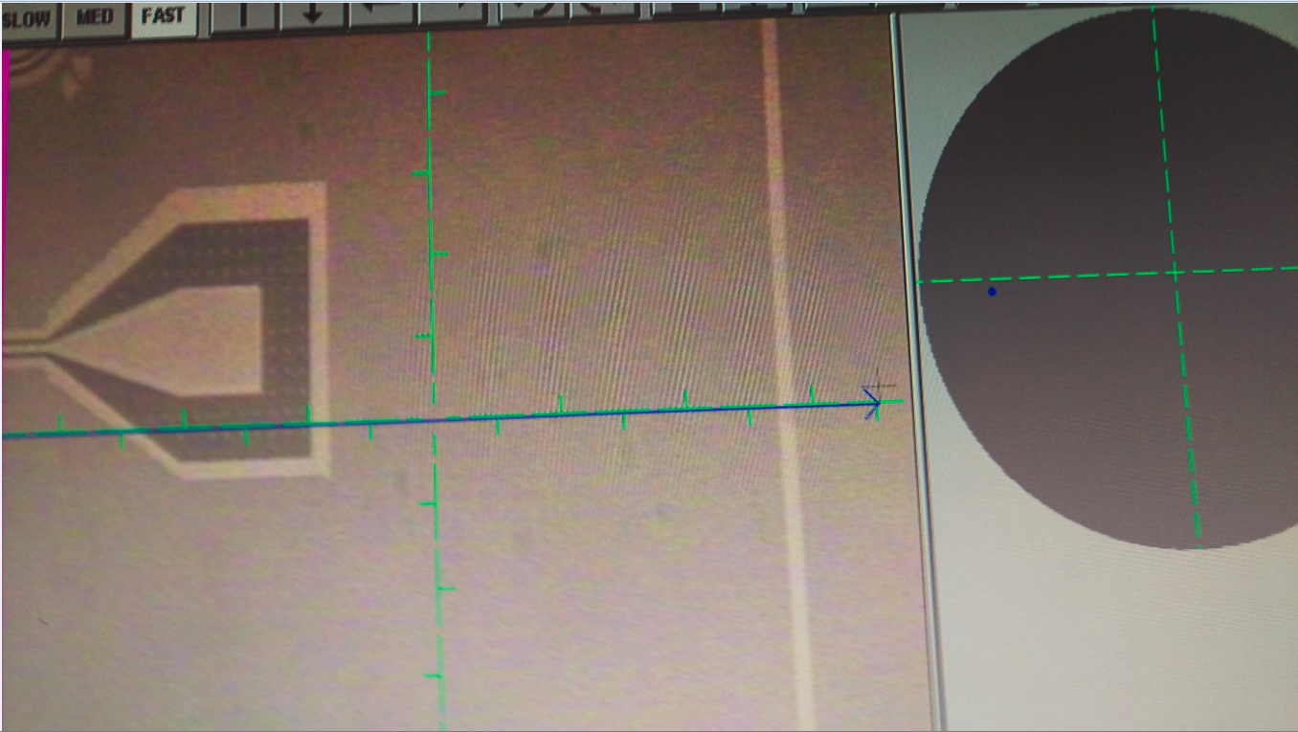
AH-DCOWxxxx - CW-V1-ZL-DE Mask
Kerf
Home Plate Border

